Slide 1
Data Science Capstone Project
Trinh Huy Hiep, Ph.D.
https://github.com/thayhiepth
04/02/2026

Slide 2
Executive Summary
The data was collected from the SpaceX API and the SpaceX Wikipedia page. I created a new column called “class” to label whether a landing was successful or not. Then, I explored the data using SQL, visualizations, Folium maps, and dashboards.
Important columns were selected as features for the models. Categorical variables were converted into numerical form using one-hot encoding. The data was also standardized, and GridSearchCV was used to find the best parameters for the machine learning models. Finally, I compared and visualized the accuracy scores of all models.
Four machine learning models were built: Logistic Regression, Support Vector Machine, Decision Tree, and K-Nearest Neighbors. All models showed similar performance, with an accuracy of about 83.33%. However, they tended to predict too many successful landings. More data is needed to improve model performance and accuracy.
2

Slide 3
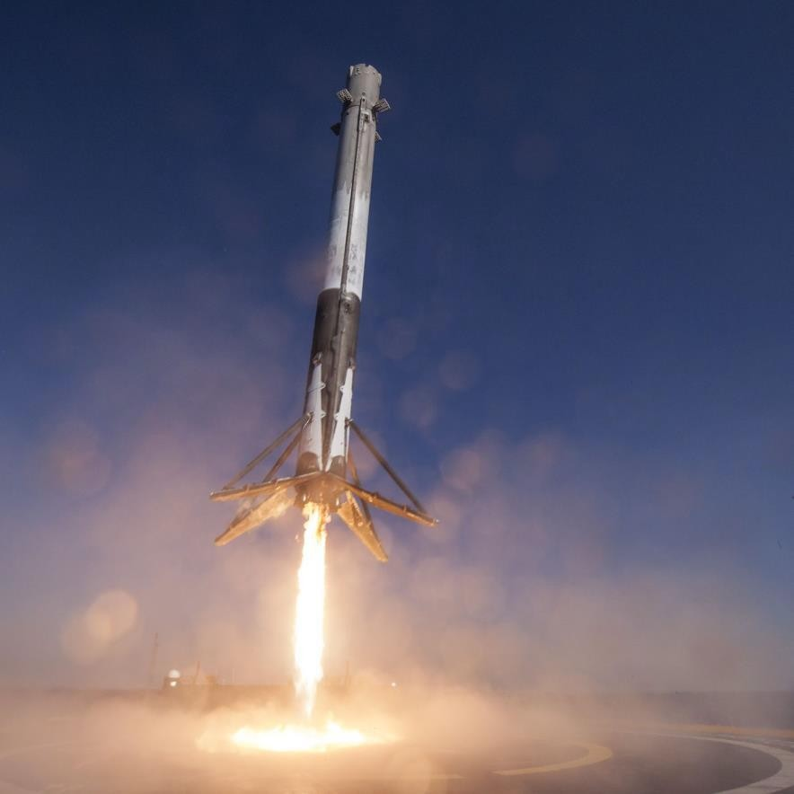
Introduction
-Background:
The commercial space industry is growing rapidly. SpaceX offers the most competitive launch price, about $62 million per launch, compared to $165 million from other providers. This lower cost is mainly due to their ability to recover and reuse the first stage of the rocket. Now, another company, Space Y, wants to compete with SpaceX.
-Problem:
Space Y has asked us to develop a machine learning model to predict whether the first stage recovery will be successful.
SpaceX Falcon 9 Rocket – The Verge
3

Slide 4
Methodology
OVERVIEW OF DATA COLLECTION, WRANGLING, VISUALIZATION, DASHBOARD, AND MODE METHODS
4

Slide 5
Methodology
-Data collection : combined data from SpaceX public API and SpaceX Wikipedia page
-Perform data wrangling: classifying true landings as successful and unsuccessful otherwise
-Perform exploratory data analysis (EDA) using visualization and SQL
-Perform predictive analysis using classification models : Tuned models using GridSearchCV
-Perform interactive visual analytics using Folium and Plotly Dash
5

Slide 6
Data collection and data wrangling methodology Data Collection
Data Collection Process:
-The data was collected using two main methods:
1.Sending API requests to the SpaceX public API
2.Web scraping a data table from the SpaceX Wikipedia page
-The next slide presents a flowchart for the API data collection process, and the following slide shows the web scraping process.
-SpaceX API Data Columns: FlightNumber, Date, BoosterVersion, PayloadMass, Orbit, LaunchSite, Outcome, Flights, GridFins, Reused, Legs, LandingPad, Block, ReusedCount, Serial, Longitude, Latitude
-Wikipedia Web Scraped Data Columns: Flight No., Launch Site, Payload, PayloadMass, Orbit, Customer, Launch Outcome, Booster Version, Booster Landing, Date, Time
6

Slide 7
Filter data to only include Falcon 9 launches
Imputate missing PayloadMass values with mean
Data Collection –
SpaceX API
Request (Space X APIs)
.JSON file + Lists(Launch Site, Booster Version, Payload Data)
Cast dictionary to a DataFrame
Json_normalize to DataFrame data from JSON
Dictionary relevant data
GitHub url:
https://github.com/thayhiepth/Applied_Data_Science_Capstone/blob/main/1.Data%20Collection%20Api.ipynb

Slide 8
Request Wikipedia
html
Cast dictionary to DataFrame
Data Collection –
Web Scraping
Iterate through table cells to extract data to dictionary
BeautifulSoup
html5lib Parser
GitHub url:
https://github.com/thayhiepth/Applied_Data_Science_Capstone/blob/main/2.Data%20Collection%20with%20Web%20Scraping.ipynb
Find launch info html table
Create dictionary

Slide 9
Data collection and data wrangling methodology Data Wrangling
Creating the Training Label:
To prepare the data for modeling, we created a new training label based on the landing outcome. Successful landings were labeled as 1, and failed landings were labeled as 0.
The original Outcome column contains two parts:
Mission Outcome
Landing Location
A new column called “class” was created. It is assigned:
1 if the Mission Outcome is True (successful)
0 if the Mission Outcome is False or None (unsuccessful)
Value mapping:
True ASDS, True RTLS, True Ocean → 1
None None, False ASDS, None ASDS, False Ocean, False RTLS → 0
GitHub url: https://github.com/thayhiepth/Applied_Data_Science_Capstone/blob/main/3.Data%20wrangling.ipynb

Slide 10
EDA and interactive visual analytics methodology EDA with Data Visualization
Exploratory Data Analysis (EDA):
Exploratory Data Analysis was performed on the following variables: Flight Number, Payload Mass, Launch Site, Orbit, Class, and Year.
Several plots were created to study the relationships between these variables, including:
Flight Number vs. Payload Mass
Flight Number vs. Launch Site
Payload Mass vs. Launch Site
Orbit vs. Success Rate
Flight Number vs. Orbit
Payload vs. Orbit
Yearly success trend
We used scatter plots, line charts, and bar charts to compare the variables and identify patterns or relationships. These insights helped determine which features could be useful for training the machine learning models.
GitHub url: https://github.com/thayhiepth/Applied_Data_Science_Capstone/blob/main/4.EDA%20with%20Visualization.ipynb

Slide 11
EDA and interactive visual analytics methodology EDA with SQL
SQL Analysis:
The dataset was loaded into an IBM DB2 database and queried using SQL with Python integration.
SQL queries were used to better understand the data and extract useful information. We analyzed details such as launch site names, mission outcomes, customer payload sizes, booster versions, and landing results.
GitHub url: https://github.com/thayhiepth/Applied_Data_Science_Capstone/blob/main/5.EDA%20with%20SQL.ipynb

Slide 12
Predictive analysis
Split label column
Score models on
Confusion Matrix
GitHub url:
https://github.com/thayhiepth/Applied_Data_Science_Capstone/blob/main/7.Machine%20Learning%20Prediction.ipynb
‘Class’ from dataset
split test set
for all models
Fit and Transform
Use GridSearchCV on LogReg, SVM, Decision Tree, and KNN models
Features using
Barplot to compare scores of models
Standard Scaler
Train_test_split
GridSearchCV
data
(cv=10) to find optimal parameters

Slide 13
Results

Slide 14
EDA with visualization results slides

Slide 15
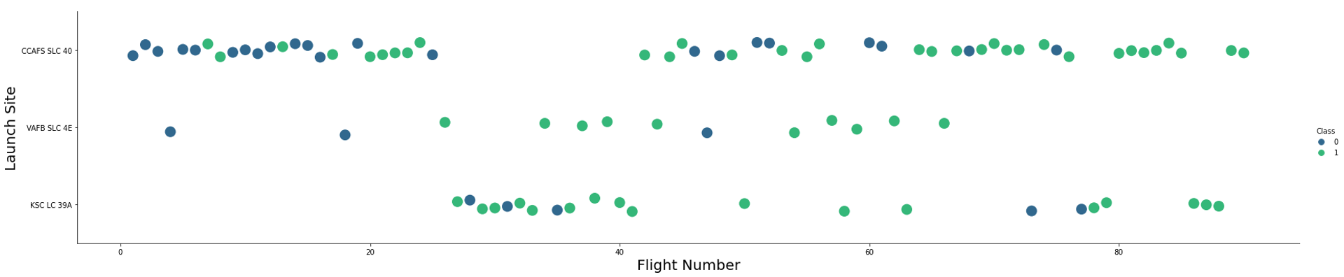
EDA with visualization results slides Flight Number vs. Launch Site
Green indicates successful launch; Purple indicates unsuccessful launch.
The graph shows that the success rate increases over time, as indicated by the flight number. There appears to be a major improvement around Flight 20, where the success rate rises significantly.The data also shows that CCAFS is the primary launch site, as it has the highest number of launches.

Slide 16
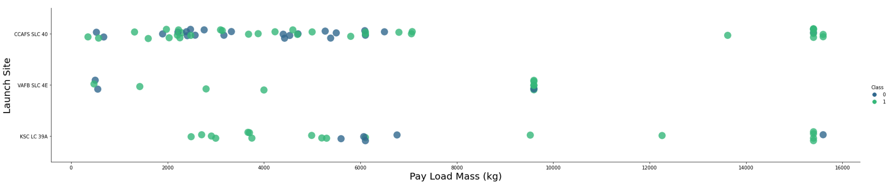
EDA with visualization results slides Payload vs. Launch Site
Green indicates successful launch; Purple indicates unsuccessful launch.
Most payload masses fall within the range of 0 to 6,000 kg. The data also suggests that different launch sites tend to handle different payload sizes, indicating variations in launch capabilities or mission types across sites.

Slide 17
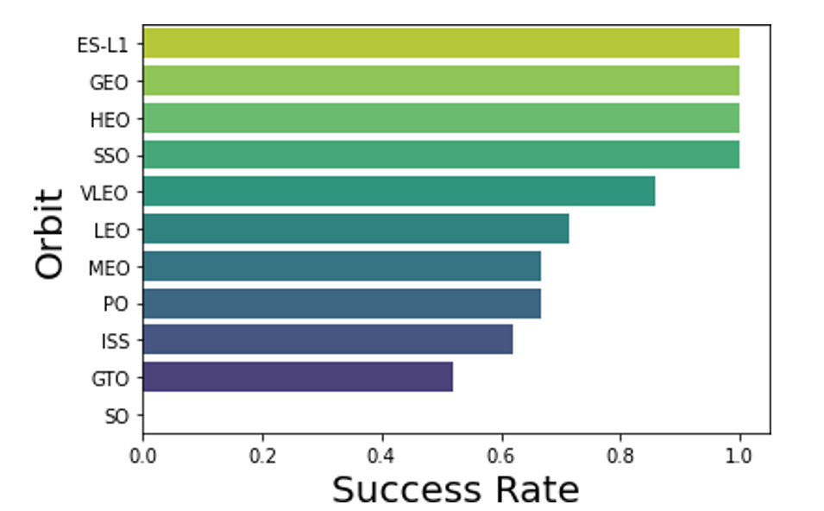
EDA with visualization results slides Success rate vs. Orbit type
Success Rate Scale with 0 as 0%
0.6 as 60% 1 as 100%
Some orbits show very high success rates. ES-L1, GEO, and HEO each have a 100% success rate, but their sample sizes are very small (1 launch each). SSO also has a 100% success rate with 5 launches.
VLEO has a good number of attempts (14) and maintains a fairly high success rate.
In contrast, SO has a 0% success rate, but it only has 1 launch.
GTO has the largest number of launches (27), with a success rate of around 50%.
Overall, results with larger sample sizes are more reliable, while smaller samples may not accurately represent performance.

Slide 18
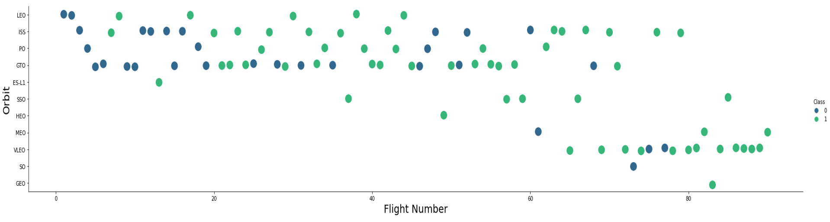
EDA with visualization results slides Flight Number vs. Orbit type
Green indicates successful launch; Purple indicates unsuccessful launch.
Launch orbit preferences changed over time, as shown by the flight number. The launch outcomes also appear to be related to these orbit choices.
At the beginning, SpaceX mainly used LEO orbits, which had moderate success. Later, the company returned to VLEO orbits in more recent launches. Overall, SpaceX seems to achieve better success rates in lower orbits and Sun-synchronous orbits.

Slide 19
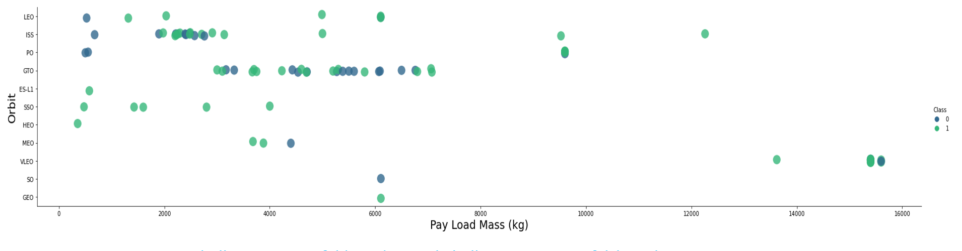
EDA with visualization results slides Payload vs. Orbit type
Green indicates successful launch; Purple indicates unsuccessful launch.
Payload mass appears to be related to the type of orbit.
LEO and SSO missions generally carry lower payload masses, while VLEO, another highly successful orbit, tends to carry heavier payloads at the higher end of the range.
This suggests that payload size may influence orbit selection and mission success.

Slide 20
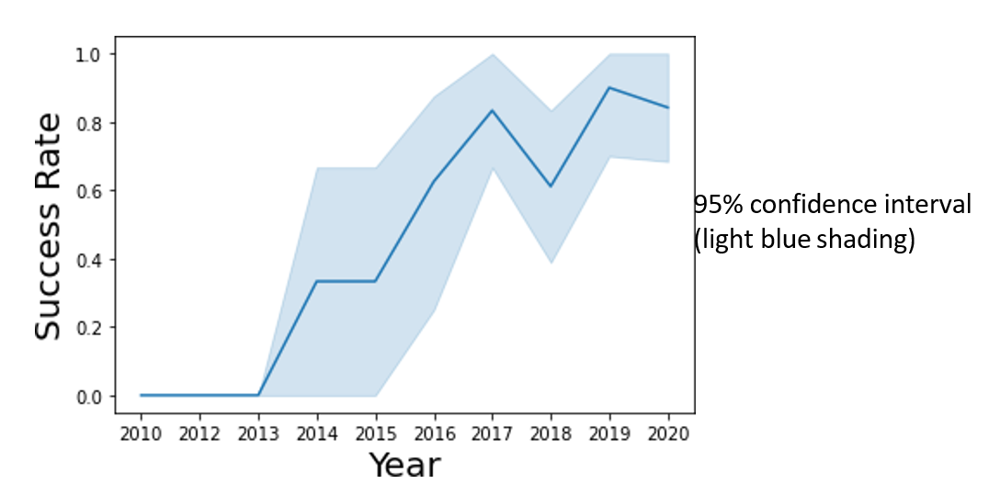
EDA with visualization results slides Launch Success Yearly Trend
The success rate has generally increased over time since 2013, with a small decline around 2018.
In recent years, the success rate has remained high at around 80%.

Slide 21
EDA with SQL results slides

Slide 22
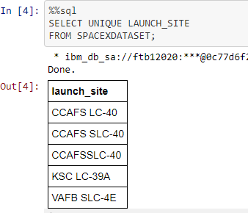
EDA with SQL results slides All Launch Site Names
We queried the database to find the unique launch site names.
The results showed that CCAFS SLC-40 and CCAFSSLC-40 likely refer to the same launch site, with differences caused by data entry errors. CCAFS LC-40 appears to be an older name for the same location.
After cleaning the data, there are likely only three unique launch sites:
CCAFS SLC-40
KSC LC-39A
VAFB SLC-4E

Slide 23
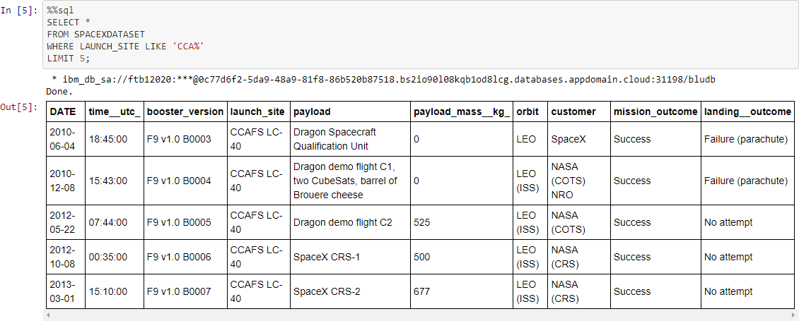
EDA with SQL results slides Launch Site Names Beginning with CCA
First five entries in database with Launch Site name beginning with CCA.

Slide 24
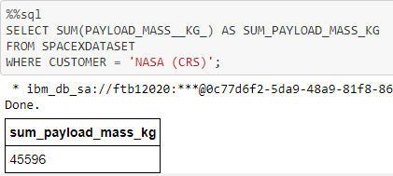
EDA with SQL results slides Total Payload Mass from NASA
This query calculates the total payload mass (in kilograms) for missions where NASA was the customer.
CRS stands for Commercial Resupply Services, which means these payloads were delivered to the International Space Station (ISS).

Slide 25
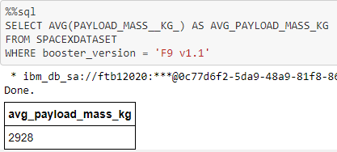
EDA with SQL results slides Average Payload Mass by F9 v1.1
This query calculates the average payload mass for launches that used the Falcon 9 v1.1 booster version.
The results show that the average payload mass for F9 v1.1 is on the lower end of the overall payload mass range.

Slide 26
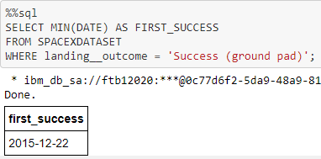
EDA with SQL results slides First Successful Ground Pad Landing Date
This query finds the date of the first successful ground pad landing.
The first ground pad landing did not occur until late 2015. However, successful landings in general began to appear starting in 2014.

Slide 27
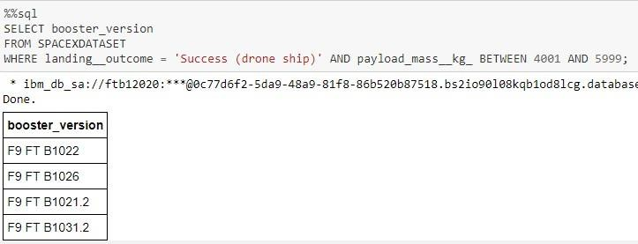
EDA with SQL results slides Successful Drone Ship Landing with Payload Between 4000 and 6000
This query returns the four booster versions that achieved successful drone ship landings with a payload mass between 4,000 and 6,000 kg (exclusive).

Slide 28
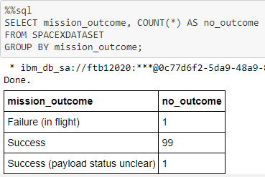
EDA with SQL results slides Total Number of Each Mission Outcome
This query counts the number of each mission outcome.
The results show that SpaceX achieves its mission objectives about 99% of the time, meaning most missions are successful. This suggests that many landing failures are planned or expected, rather than true mission failures.
There is also one launch with an unclear payload status and one launch that failed during flight.

Slide 29
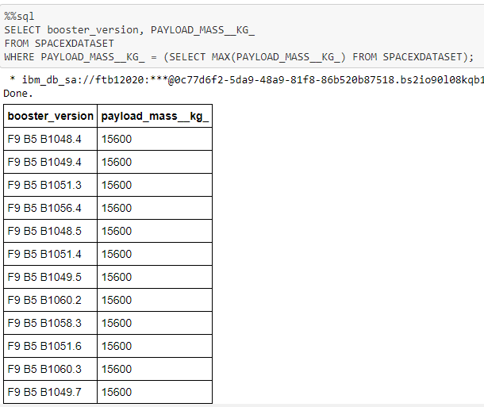
EDA with SQL results slides Boosters that Carried Maximum Payload
This query returns the booster versions that carried the highest payload mass of 15,600 kg.
These boosters are very similar and all belong to the F9 B5 (B10xx.x) series. This suggests that payload mass may be related to the booster version used, with newer or upgraded boosters capable of carrying heavier payloads.

Slide 30
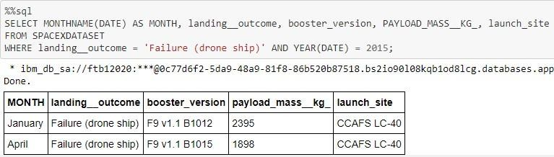
EDA with SQL results slides 2015 Failed Drone Ship Landing Records
This query returns the month, landing outcome, booster version, payload mass (kg), and launch site for launches in 2015 where Stage 1 failed to land on a drone ship.
The results show that there were two such cases.

Slide 31
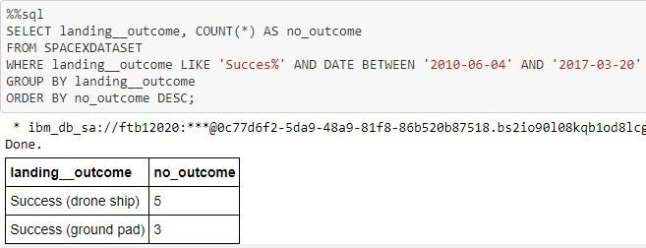
EDA with SQL results slides Ranking Counts of Successful Landings Between 2010-06-04 and 2017-03-20
This query returns a list of successful landings between June 4, 2010 and March 20, 2017 (inclusive).
There are two types of successful landings: drone ship landings and ground pad landings.
During this time period, there were 8 successful landings in total.

Slide 32
Interactive map with Folium-related slides

Slide 33
Perform interactive visual analytics Build an interactive map with Folium
Folium Map Visualization:Folium maps were used to mark launch sites, as well as successful and unsuccessful landings. The maps also show the proximity of launch sites to key locations such as railways, highways, the coast, and nearby cities.This helps us understand why launch sites are placed in certain areas and allows us to visualize how landing success relates to location.
GitHub url:
https://github.com/thayhiepth/Applied_Data_Science_Capstone/blob/main/6.Interactive%20Visual%20Analytics%20with%20Folium.ipynb

Slide 34
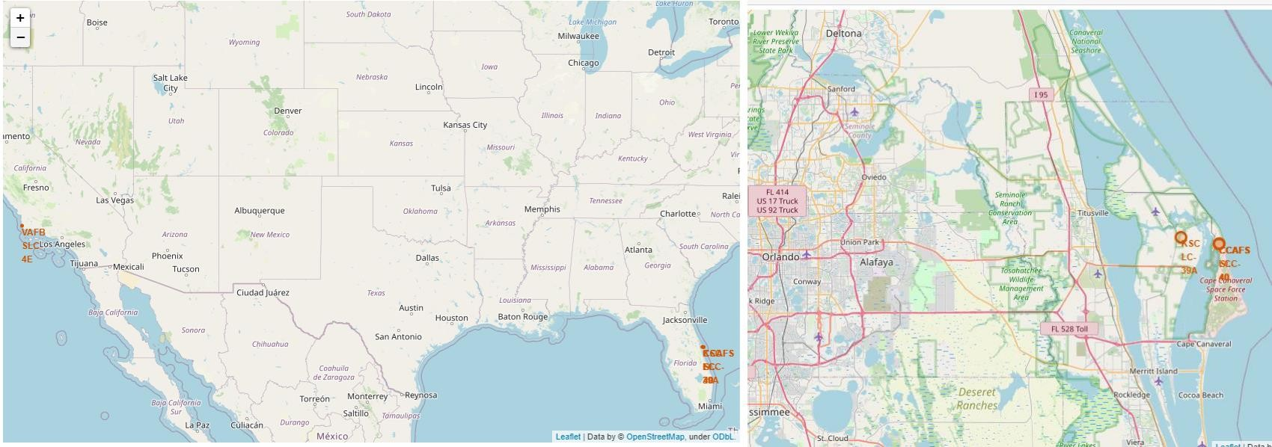
Interactive map with Folium-related slides Launch Site Locations
The left map shows all launch sites across the United States. The right map focuses on the two Florida launch sites, which are located very close to each other.
All launch sites are positioned near the ocean, likely for safety and easier rocket recovery operations.

Slide 35
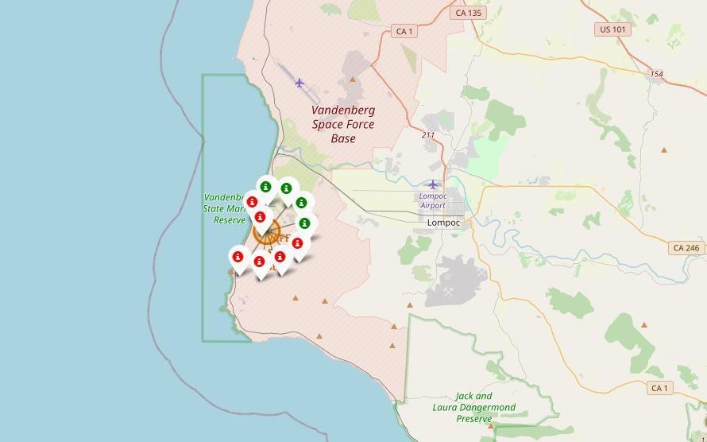
Interactive map with Folium-related slides Color-Coded Launch Markers
Clusters on the Folium map can be clicked to view individual landings. Green icons represent successful landings, and red icons represent failed landings.
In this example, VAFB SLC-4E shows 4 successful landings and 6 failed landings.

Slide 36
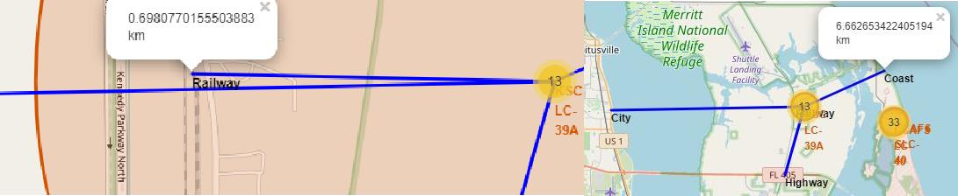
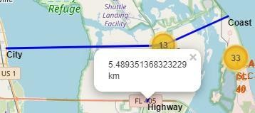
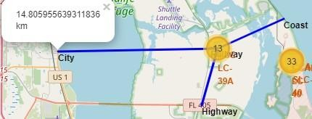
Interactive map with Folium-related slides Key Location Proximities
Using KSC LC-39A as an example, the launch site is located close to railways to support the transport of large rocket parts and supplies. It is also near highways for easy movement of personnel and equipment.
Additionally, the site is close to the coast and far from major cities. This location improves safety, as any launch failures are more likely to fall into the ocean rather than populated areas.

Slide 37
Plotly Dash-related slides

Slide 38
Perform interactive visual analytics Build a Dashboard with Plotly Dash
Dashboard Visualization:
The dashboard includes a pie chart and a scatter plot to explore launch performance.
The pie chart shows the distribution of successful landings. Users can view results for all launch sites combined or select individual launch sites to see their specific success rates.
The scatter plot allows two inputs: selecting all sites or a single site, and adjusting the payload mass using a slider ranging from 0 to 10,000 kg.
The pie chart helps visualize overall success rates by launch site, while the scatter plot shows how landing success changes based on launch site, payload mass, and booster version.
GitHub url:
https://github.com/thayhiepth/Applied_Data_Science_Capstone/blob/main/spacex_dash_app.py

Slide 39
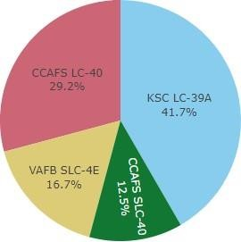

Plotly Dash dashboard results slides Successful Launches Across Launch Sites
This chart shows the distribution of successful landings across all launch sites.
CCAFS LC-40 is the old name for CCAFS SLC-40, so when combined, CCAFS and KSC have a similar number of successful landings. Most of these successes occurred before the site name was changed.
VAFB has the fewest successful landings, which may be due to a smaller number of launches or the added difficulty of launching from the West Coast.

Slide 40
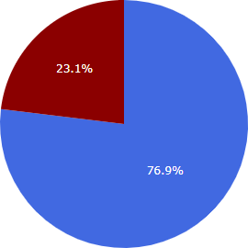

Plotly Dash dashboard results slides Highest Success Rate Launch Site
KSC LC-39A has the highest success rate, with 10 successful landings and 3 failed landings.

Slide 41
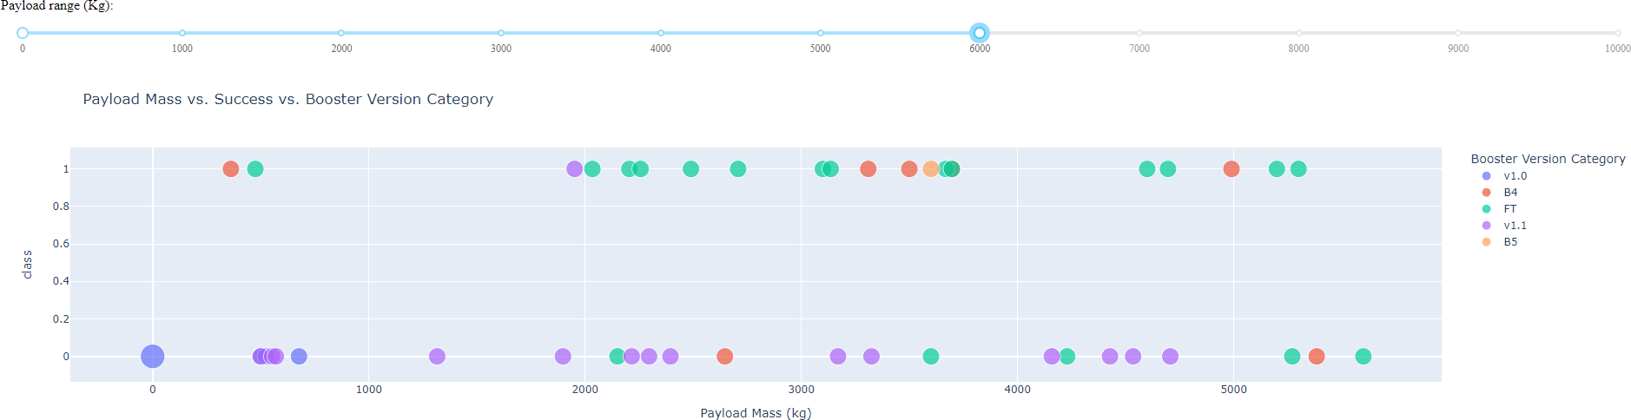
Plotly Dash dashboard results slides Payload Mass vs. Success vs. BoosterVersion Category
The Plotly dashboard includes a payload range selector, but it is currently set from 0 to 10,000 kg, even though the maximum payload is 15,600 kg.
In the scatter plot, class = 1 represents a successful landing and class = 0 represents a failure. The plot also uses color to show booster version categories and point size to represent the number of launches.
Within the 0–6,000 kg range, there are two failed landings with zero payload mass, which is an interesting observation.

Slide 42
Paredictive Analysis (classification) result slides

Slide 43
Predictive analysis (classification) results slides Predictive Analysis
GRIDSEARCHCV(CV=10) ON LOGISTIC REGRESSION, SVM, DECISION TREE, AND KNN

Slide 44
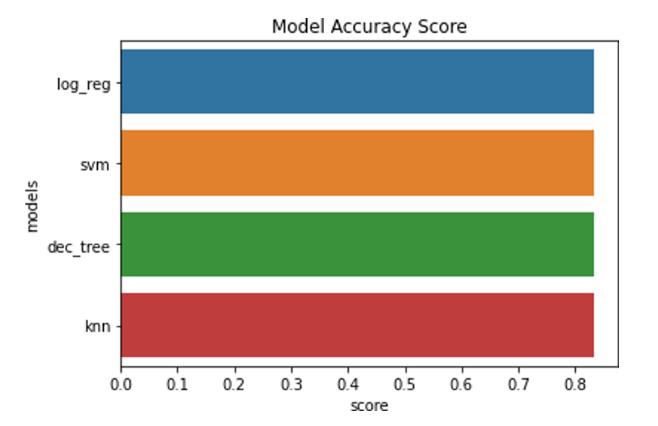
Predictive analysis (classification) results slides Classification Accuracy
All models achieved nearly the same test accuracy of 83.33%. However, the test set is small, with only 18 samples.
Because of this small size, the accuracy results may vary greatly between runs. For example, the Decision Tree model shows noticeable changes in performance when repeated.
To better evaluate and choose the best model, more data is needed.

Slide 45
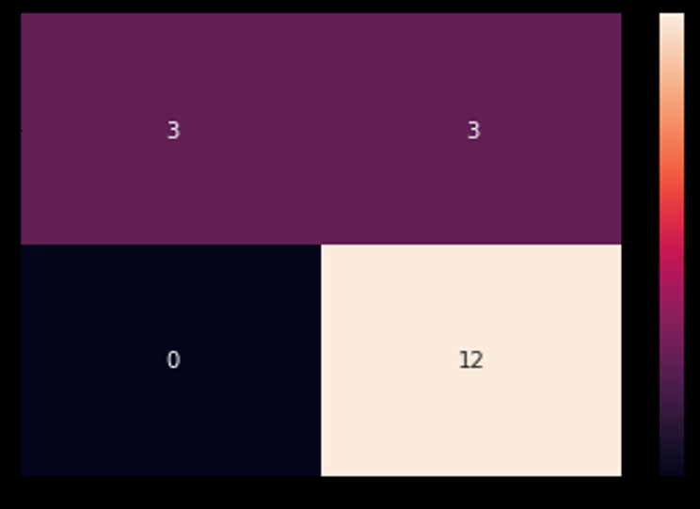
Predictive analysis (classification) results slides Confusion Matrix
Correct predictions are on a diagonal from top left to bottom right.
Since all models performed similarly on the test set, they produced the same confusion matrix.
The models correctly predicted:
12 successful landings (true positives)
3 unsuccessful landings (true negatives)
However, they incorrectly predicted:
3 successful landings when the landing actually failed (false positives)
This shows that the models tend to overpredict successful landings.

Slide 46
CONCLUSION
Project Summary:
Our task was to develop a machine learning model for Space Y to help them compete with SpaceX. The goal of the model is to predict whether Stage 1 will land successfully, which could save about $100 million per launch by allowing rocket recovery and reuse.
We collected data from the SpaceX public API and by web scraping the SpaceX Wikipedia page. The data was cleaned, labeled, and stored in a DB2 SQL database. We also built an interactive dashboard to visualize launch and landing trends.
Using this data, we trained several machine learning models and achieved an accuracy of about 83%.
Space Y can use this model to estimate the likelihood of a successful Stage 1 landing before launch, helping them make better operational and financial decisions. However, collecting more data would likely improve the model’s accuracy and help determine the best-performing approach.

